Slide 1
HDMI Video Divider
HVD-1
DigiPen Institute of Technology
Fall 2014
Cassandra Chow

Slide 2
Project Motivations
FPGA Development
Hardware implementation of software
Reconfigurable
Communication Protocols
Rules that define format of data exchanges

Slide 3
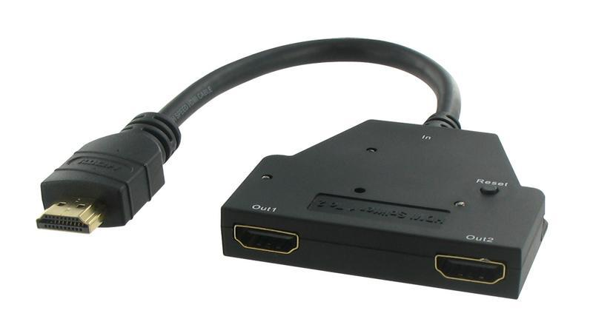
Project Concept
An FPGA based device designed to duplicate or spatially divide display data from any HDMI signal

Slide 4
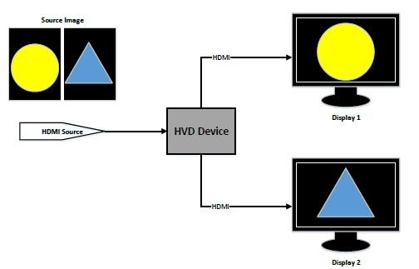
HVD Use Model

Slide 5
Implementation
Altera DE2-115
Analog Devices HDMI Interface ASIC
HSMC to GPIO daughter board
I2C protocol intercommunication

Slide 6
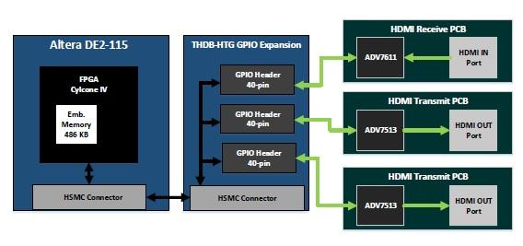
System Block Diagram

Slide 7
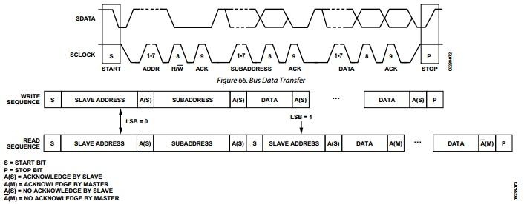
I2C Communication

Slide 8
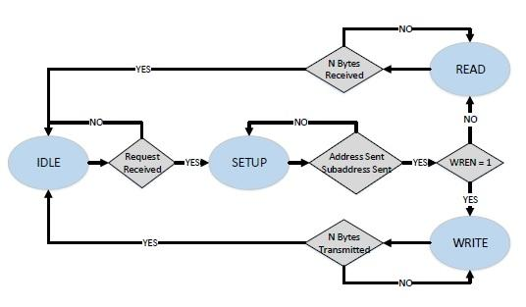
I2C as a Finite State Machine

Slide 9
Develop, Test, Debug
Quartus II, Verilog HDL
ModelSim waveform view
Oscilloscope Tests
MSO protocol interpreter

Slide 10
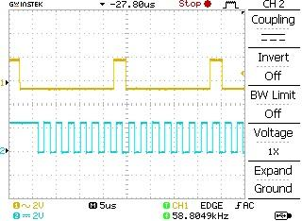
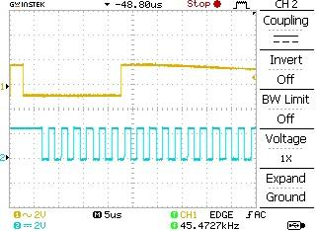
Oscilloscope Test Data
Write Read

Slide 11
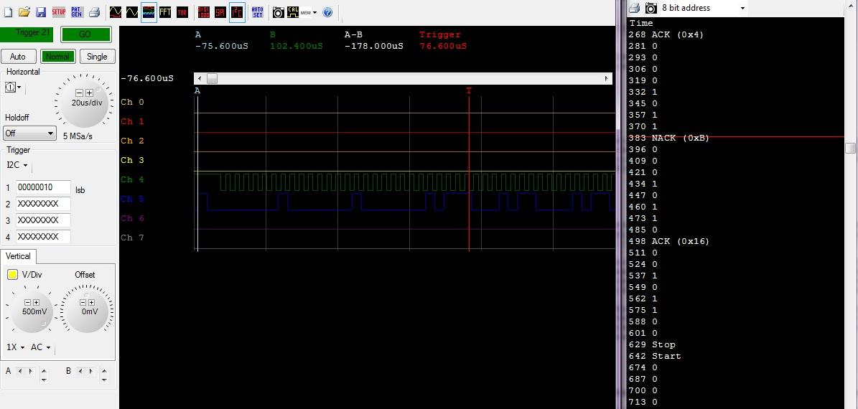
MSO Test Data

Slide 12
HDMI Receiver PCB
Eagle

Slide 13
System Integration
Requires verifying I2C communication
Points of uncertainty hinder testing
Possible bugs
I2C is incorrect
PCB is flawed
Debug Solution: Acquire reliable I2C source

Slide 14
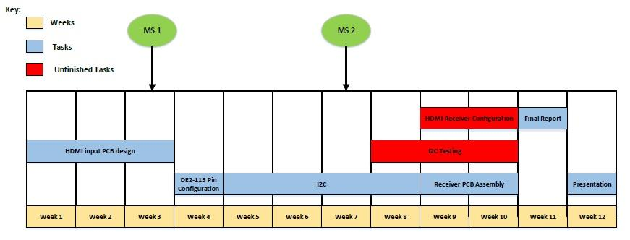
Fall Timeline

Slide 15
Next Semester
Test and Debug
HDMI Transmitter PCB
DE2-115 Memory Interface
HDMI Receive/Transmit Software

Slide 16
Acknowledgements
Lukas van Ginneken
Jeremy Thomas
Christopher Theriault
Nicholas Rivera
Johnny Sim

